Slide 1
Hackers & ‘Clickers’
Partners in crime!

Slide 2
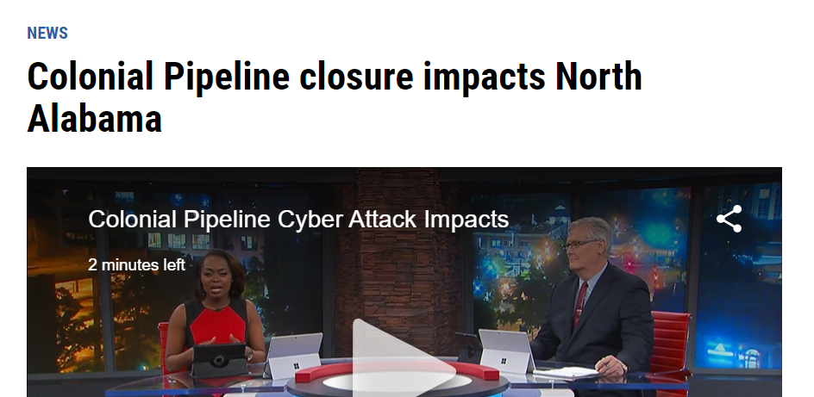
Happening Now!

Slide 3
What is ‘Hacking’
it is the unauthorized access to or control over computer network systems
Hacker: someone who utilizes their technical know-how of bugs or exploits to break into computer systems and access data

Slide 4
E-Mail
Passwords:
long, characters, Upper/lower, Numbers
Two factor authorization (2fa)
Change periodically
Assume no privacy!
Email is forever!

Slide 5
Phishing
Clickbait
Almost identical web pages
Misspelled web addresses
Asking for personal information
Seems to know a lot about you
Sent from known email addresses

Slide 6
Links and attachments
Virus in attachments
Virus in pictures
Links to really bad stuff
Underlined words are Links!

Slide 7
Information your PC sends out
Ip address

Slide 8
Summary!
Be skeptical about links and attachments regular software updates Change your password regularly phishing Watch what you click

Slide 9
Summary!
Do not use free Wi-Fi
Don’t access personal info outside personal wifi
public Wi-Fi: Do not use!
Turn off anything you don’t need (GPS, etc.)

Slide 10
How client servers communicate
https://computer.howstuffworks.com/web-server.htm

